Slide 1
Arrays in a Function
ELEC1006: ENGINEERING COMPUTING

Slide 2

Arrays as Function Arguments
When passing an array to a function, it is common to pass array size so that a function knows how many elements to process:
showScores(tests, ARRAY_SIZE);
Array size must also be reflected in prototype, header:
void showScores(int [], int);
// function prototype
void showScores(int tests[], int size)
// function header
PAGE 2

Slide 3
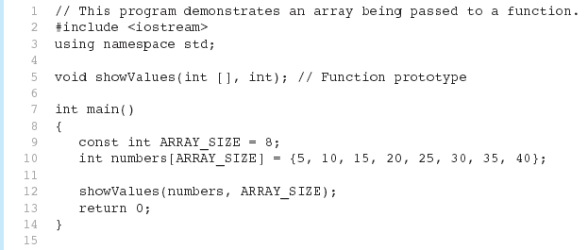
Example 1
(Program Continues)
PAGE 3

Slide 4
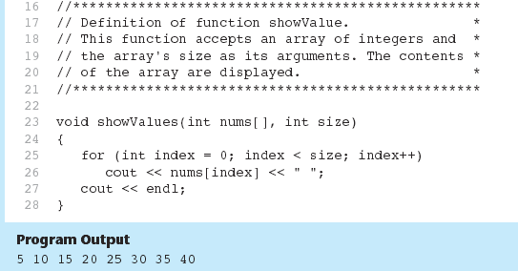
Example 1 (continued)
PAGE 4

Slide 5
Modifying Arrays in a Function
Array names in functions are like reference variables – changes made to array in a function are reflected in the actual array in the calling function.
Need to exercise caution that array is not inadvertently changed by a function.
PAGE 5

Slide 6
More info
[1] cplusplus.com: Arrays
https://www.cplusplus.com/doc/tutorial/arrays/
[2] leanrcpp.com: 6.1 – Arrays (Part I) https://www.learncpp.com/cpp-tutorial/61-arrays-part-i/
[3] learncpp.com: 6.2 – Arrays (Part II)
https://www.learncpp.com/cpp-tutorial/62-arrays-part- ii/
[4] learncpp.com: 6.3 – Arrays and loops
https://www.learncpp.com/cpp-tutorial/63-arrays-and- loops/
PAGE 6

